Slide 1
MVC in JSP

Slide 2
MVC in JSP
In this module we will see below topics
MVC in JSP

Slide 3
MVC in JSP
MVC stands for Model View and Controller. It is a design pattern that separates the business logic, presentation logic and data.
Controller acts as an interface between View and Model. Controller intercepts all the incoming requests.
Model represents the state of the application i.e. data. It can also have business logic.
MVC Advantages
This model is suitable for large applications.
It allows use of reusable software components to design the business logic.
It easy to maintain and test.
MVC Disadvantage
If we change the code in controller, we need to recompile the class and redeploy the application.

Slide 4
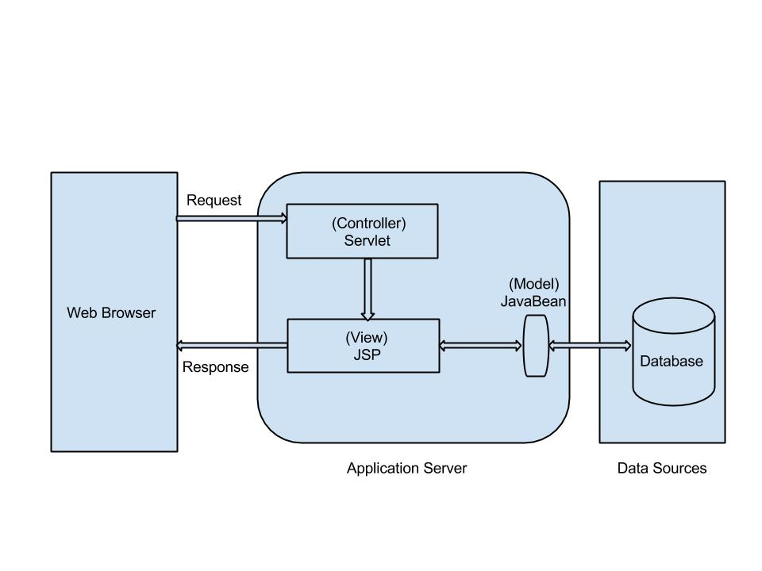
MVC in JSP
As shown in above model Servlet acts as Controller, JSP acts as View and JavaBean acts as Model.
In this architecture, Controller receives requests which are transferred to data sources by View component and Model component. After the requests are serviced, JSP pages i.e. View component send responses back to client.

Slide 5
MVC in JSP Example Duration:30 min
We are taking the example of a form with two variables "email" and "password" which is our view layer.
Once the user enters email, and password and clicks on submit then the action is passed in ControllerServlet where email and password are passed.
This ControllerServlet is controller layer. Here in ControllerServlet the request is sent to the bean object which act as model layer.
The email and password values are set into the bean and stored for further purpose.
From the bean, the value is fetched and shown in the view layer.
Here we will create a jsp form which has two fields as parameter "email" and "password" and this request need to be forwarded to a controller ControllerServlet.java, which is passed in action.The method through which it is passed is POST method.
Here we are using request dispatcher object to pass the success message to success.jsp

Slide 6
MVC in JSP Example Contd..
ControllerServlet.java
package com.test.mvc;
import java.io.IOException;
import javax.servlet.RequestDispatcher;
import javax.servlet.ServletException;
import javax.servlet.http.HttpServlet;
import javax.servlet.http.HttpServletRequest;
import javax.servlet.http.HttpServletResponse;
import javax.servlet.ServletException;
import javax.servlet.annotation.WebServlet;
@WebServlet("/ControllerServlet")
public class ControllerServlet extends HttpServlet {
private static final long serialVersionUID = 1L;
public ControllerServlet() {
super();
// TODO Auto-generated constructor stub
}
protected void doGet(HttpServletRequest request, HttpServletResponse response) throws ServletException, IOException {
// TODO Auto-generated method stub
response.getWriter().append("Served at: ").append(request.getContextPath());
}
TestBean.java
package com.test.mvc;
import java.io.Serializable;
public class TestBean implements Serializable{
private String email="null";
private String password="null";
public String getEmail() {
return email;
}
public void setEmail(String email) {
this.email = email;
}
public String getPassword() {
return password;
}
public void setPassword(String password) {
this.password = password;
}
}

Slide 7
MVC in Example Contd…
protected void doPost(HttpServletRequest request, HttpServletResponse response) throws ServletException, IOException {
// TODO Auto-generated method stub
String email=request.getParameter("email");
String password=request.getParameter("password");
TestBean testobj = new TestBean();
testobj.setEmail(email);
testobj.setPassword(password);
request.setAttribute("testbean",testobj);
RequestDispatcher rd=request.getRequestDispatcher("success.jsp");
rd.forward(request, response);
}}
MVCForm.jsp
<%@ page language="java" contentType="text/html; charset=ISO-8859-1" pageEncoding="ISO-8859-1"%>
<!DOCTYPE html PUBLIC "-//W3C//DTD HTML 4.01 Transitional//EN" "http://www.w3.org/TR/html4/loose.dtd">
<html>
<head>
<meta http-equiv="Content-Type" content="text/html; charset=ISO-8859-1">
<title>MVC Example</title>
</head>
<body>
<form action="ControllerServlet" method="POST">
Email: <input type="text" name="email">
<br />
Password: <input type="text" name="password" />
<input type="submit" value="Submit" />
</form>
</body>
</html>
Success.jsp
<%@ page language="java" contentType="text/html; charset=ISO-8859-1" pageEncoding="ISO-8859-1"%>
<%@page import="com.test.mvc.TestBean"%>
<!DOCTYPE html PUBLIC "-//W3C//DTD HTML 4.01 Transitional//EN" "http://www.w3.org/TR/html4/loose.dtd">
<html>
<head>
<meta http-equiv="Content-Type" content="text/html; charset=ISO-8859-1">
<title> Success Page</title>
</head>
<body>
<%TestBean test=(TestBean)request.getAttribute("testbean");
out.print("Welcome, "+test.getEmail());
%>
</body>
</html>

Slide 8
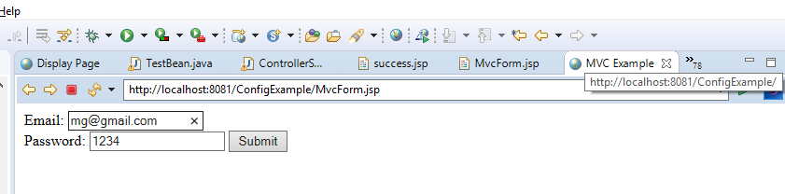
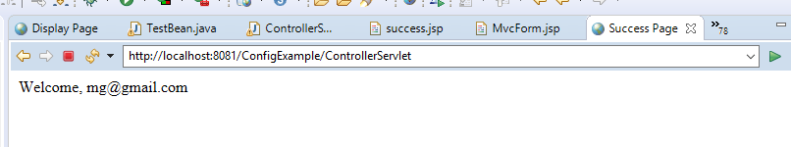
MVC in JSP Example Contd…
When you execute the above code, you get the following output:
When you click on Mvc_Form.jsp you get the form with email and password with the submit button.
Once you enter email and password to the form and then click on submit

Slide 9

Thank You

